Slide 1


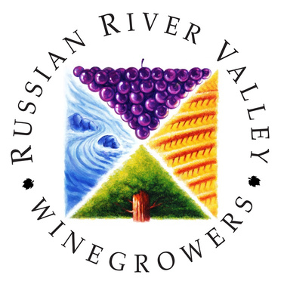
Russian River Valley
PINOT & BEYOND

Slide 2
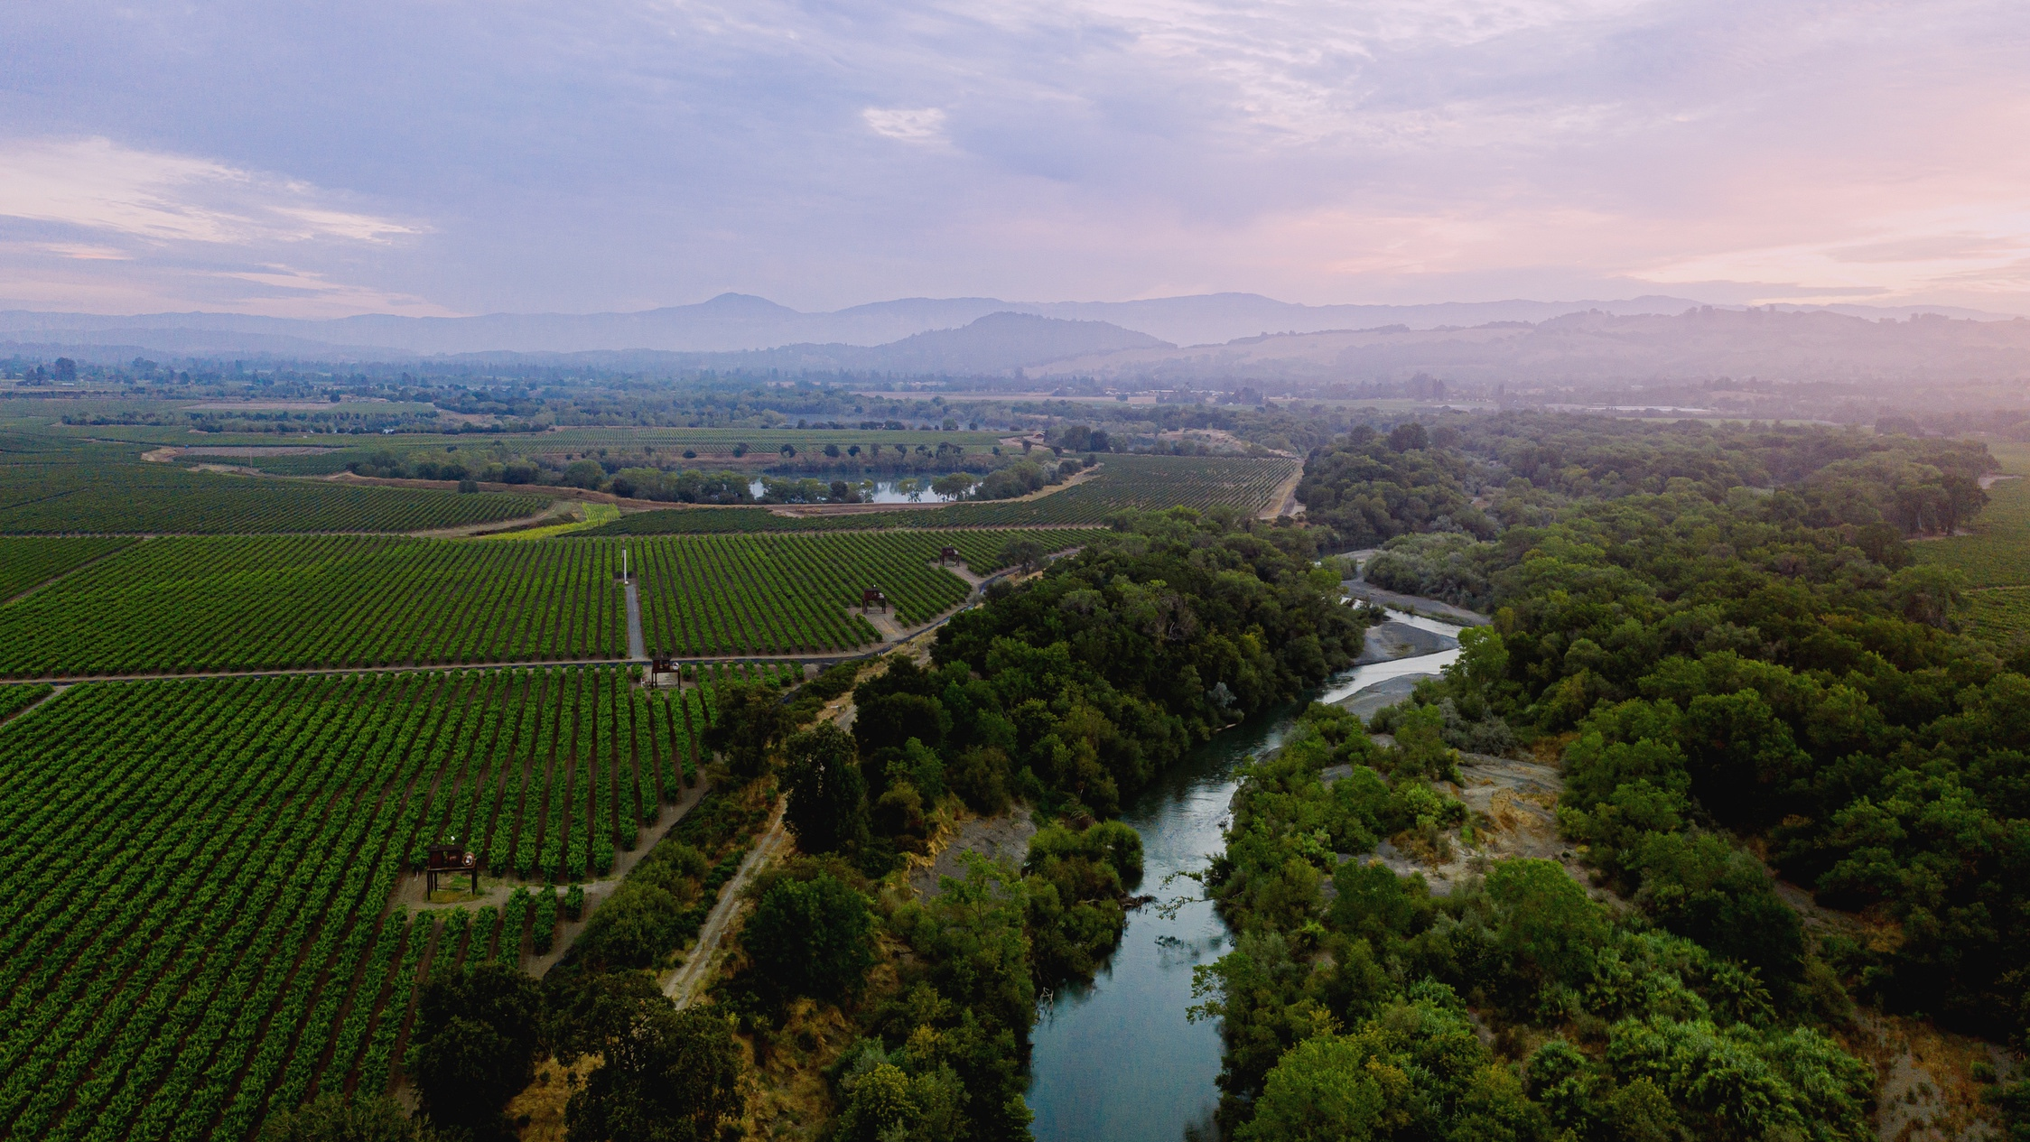


Slide 3



  The Russian River Valley is located in Northern California, approximately 55 miles north of San Francisco - just a one-hour drive most days!

Slide 4

Santa
Rosa
  The Russian River Valley is located in Sonoma County, just west of the city of Santa Rosa
  Westernmost areas of the Russian River Valley are just 10 miles from the Pacific Ocean
San Francisco
Bay Area

Slide 5
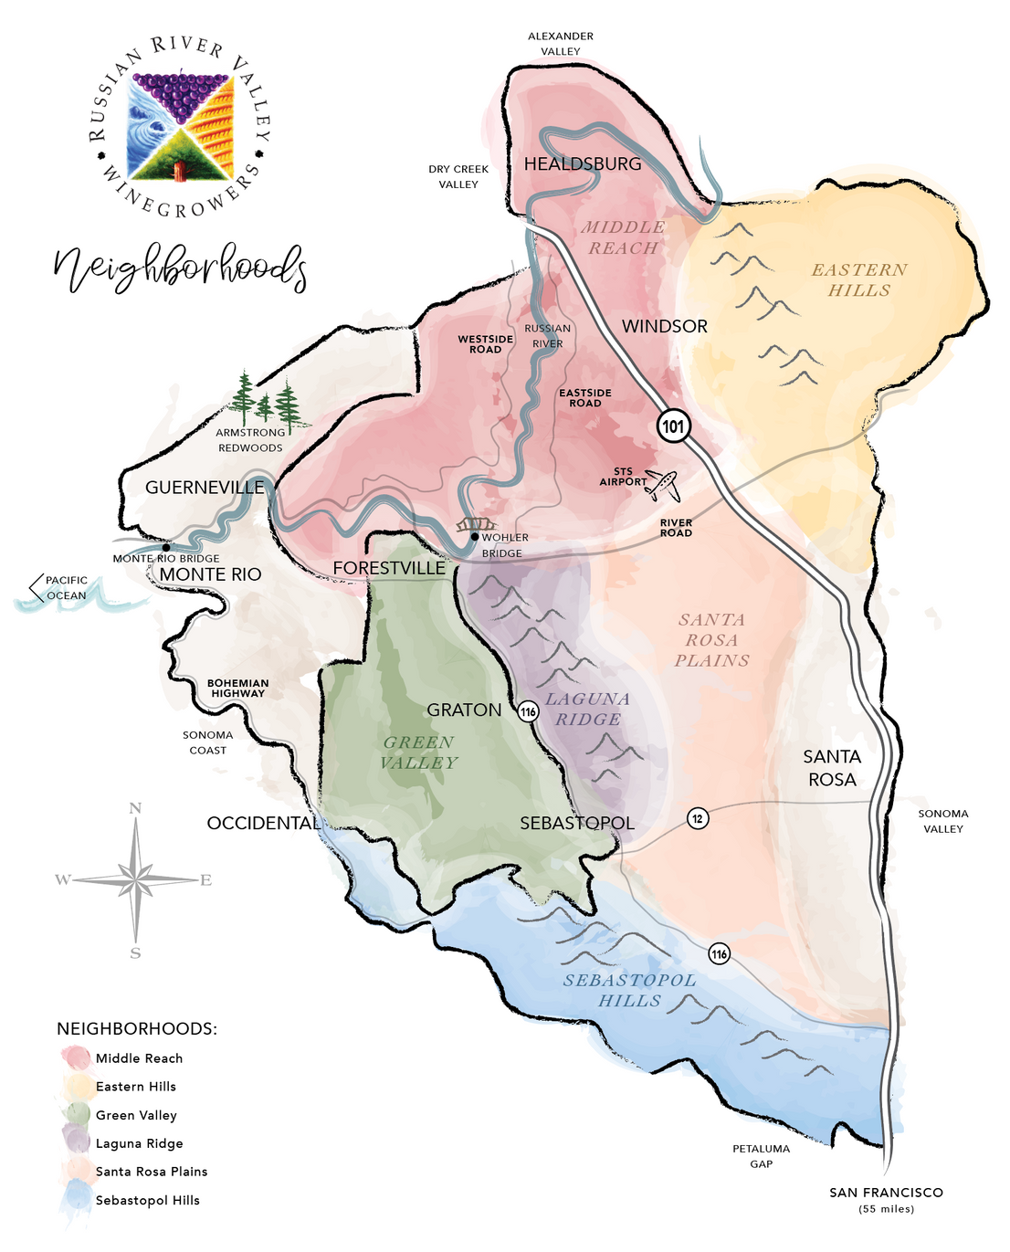
  The Russian River Valley encompasses 126,600 acres and can be broken into six smaller regions or "neighborhoods" with unique attributes

Slide 6


THE AVA
  The Russian River Valley American Viticulture Area (AVA) earned its AVA status in 1983
  The Russian River Valley is the second largest AVA in Sonoma County, with Sonoma Coast being largest
  The Russian River Valley Winegrowers (RRVW) was founded in 1996. Today, it has over 200 members representing both wineries and grape growers
  The mission of RRVW is to promote the AVA as the premier region for growing cool climate grapes while producing wines that showcase the diversity of the AVA's 6 neighborhoods

Slide 7

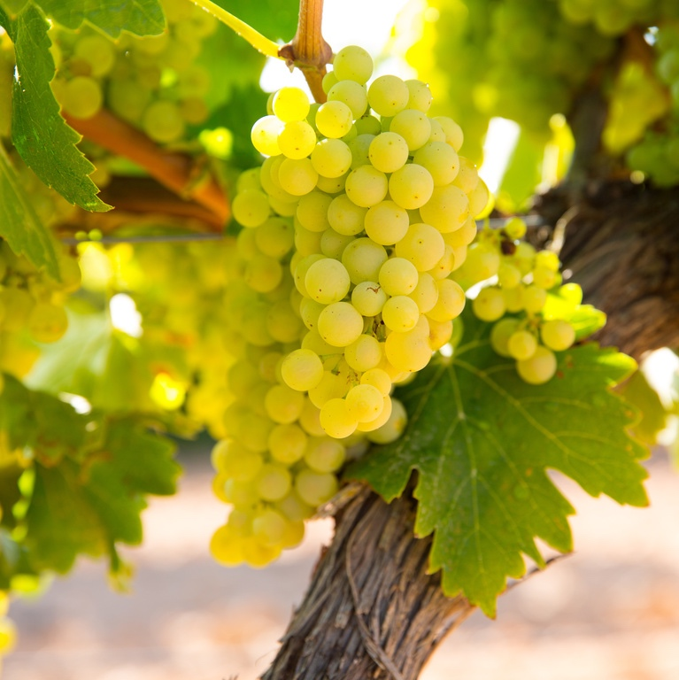
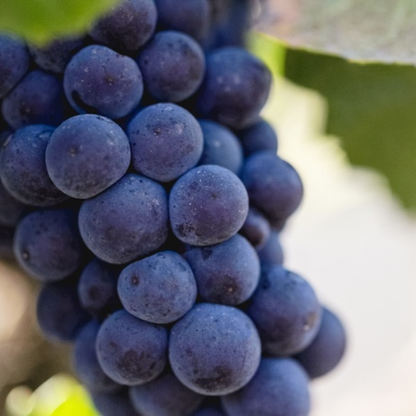
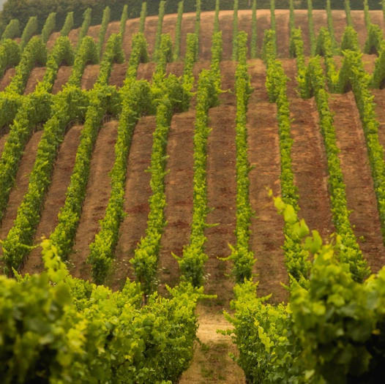
Chardonnay
Pinot Noir
Additional Varieties
Approximately 42% of the grapes harvested in the region are Chardonnay
Approximately 29% of the grapes harvested in the region are Pinot Noir
The Russian River Valley is an incredibly diverse AVA, growing many excellent cool-climate wine grape varieties

Slide 8

Other
9%
Syrah
2%
Cabernet Sauvignon
4%
Merlot
5%
Chardonnay
42%
Zinfandel
9%
Pinot Noir
29%

Slide 9
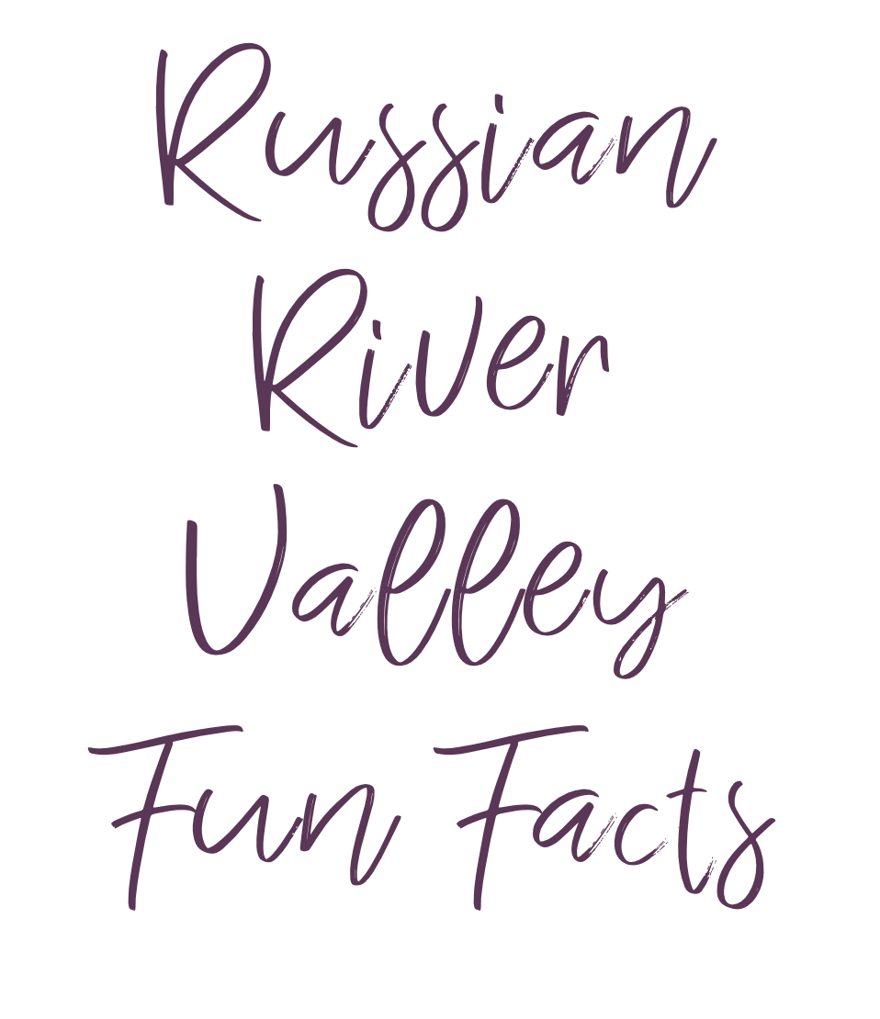
There are approximately 16,000 acres (6,475 hectares) of wine grapes planted in the Russian River Valley AVA
RRVW is aligned with Sonoma County Winegrowers' commitment to sustainability with the majority of grape acreage being certified sustainable
The Russian River Valley has a deep agricultural heritage having been at different times, a popular region for redwood groves, apples, hops, prunes and other diversified agriculture
When the Russian River Valley AVA was established in 1983, it was in good company! Five other Sonoma County AVAs were approved that year including: Carneros, Chalk Hill, Dry Creek Valley, Green Valley and Knight's Valley
The Russian River Valley AVA was expanded by 30,200 acres (12,222 hectares) in 2005 to cover a total of 126,600 acres (51,233 hectares) from the original 96,400 acres (6,475 hectares)

Slide 10
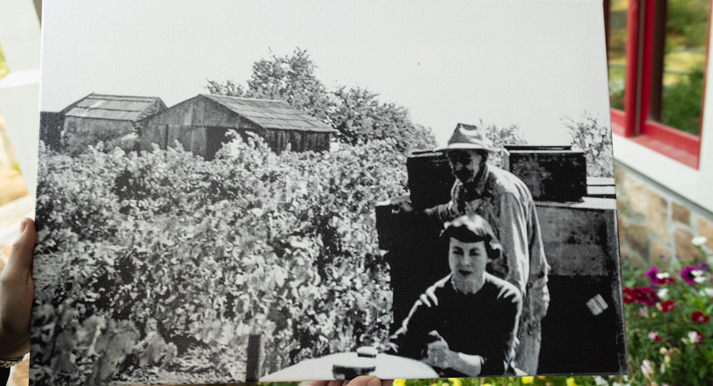

Timeline

Slide 11

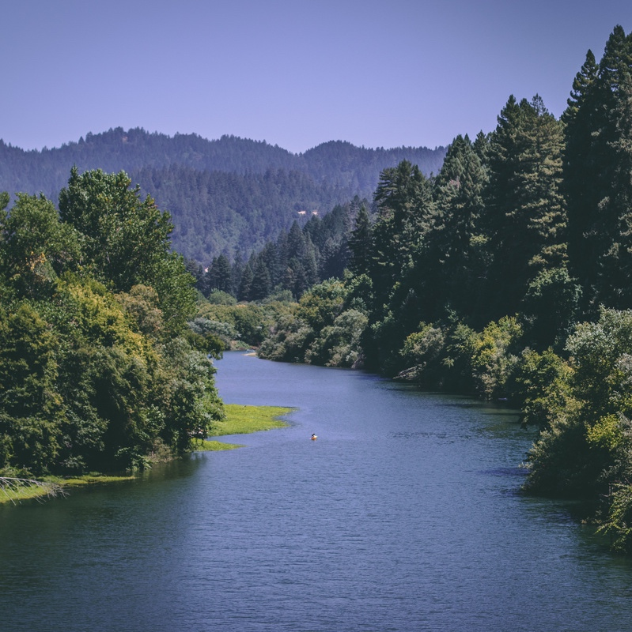
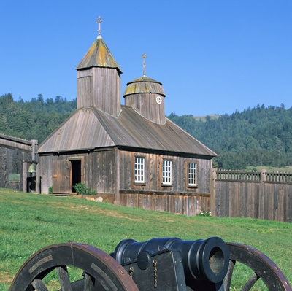
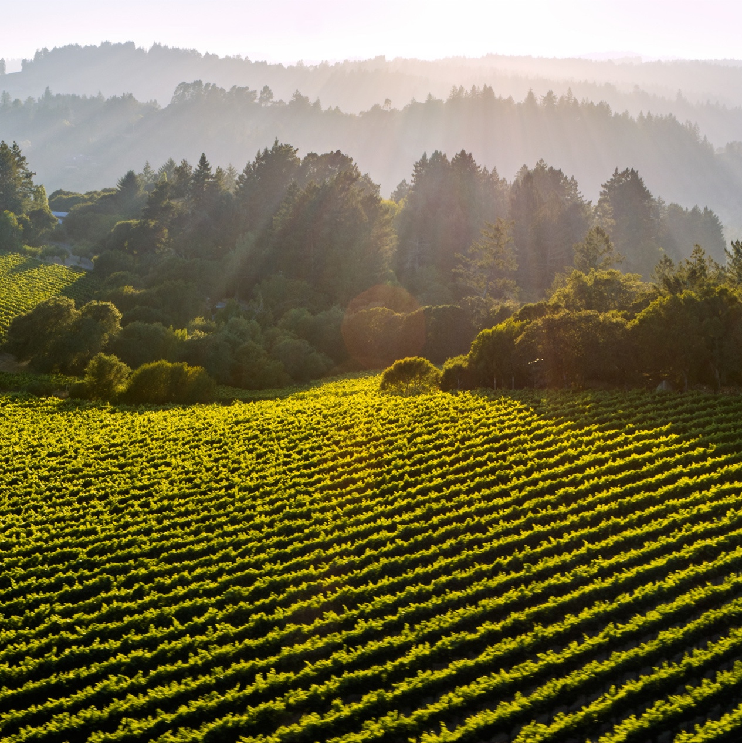
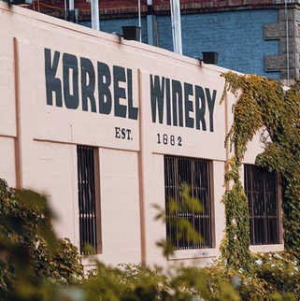
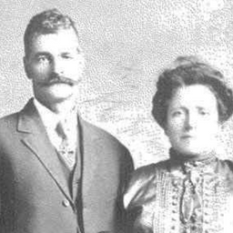
5000 BCE
1812
1849
1882
1887
Pomo Indians arrive along the Russian River
Giuseppe & Luisa Martinelli arrive from Italy
Fort Ross is established
California
Gold Rush
Korbel is established
By the beginning of the 18th century, the Pomo were well established along the river, living in dwellings called wikiups
Russian fur traders establish the fort 11 miles North of Jenner and in 1836 plant the areas first vineyards in present-day Graton
Russians abandon Fort Ross, selling it to John Sutter in 1841, just seven years before he would find gold at Sutter's Mill; and setoff the gold rush of 1849
The Korbel brothers finish their winery, focused on making european-style wines, including using méthode champanoise for "California Champagne"
Within two years, the Martinellis purchased land and planted Zinfandel and Muscat Alexandria vines on a 60-degree slope, a vineyard still in production today and known as "Jackass Hill"

Slide 12


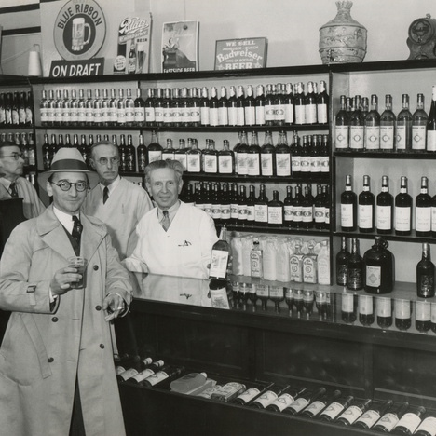
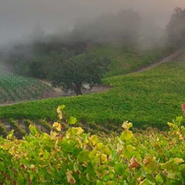
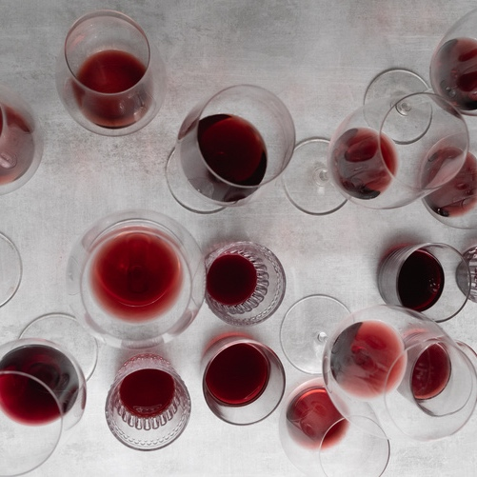
1920
1933
1959
1973
Prohibition Repealed
Rochioli Vineyard Planted
A Big Year
for Pinot
Prohibition
The early 1900s saw over 22K acres of wine grapes & 256 wineries in Sonoma County. Prohibition would all but decimate the industry with only 50 wineries surviving by making sacrament wine and selling to home winemakers
Joe Rochioli Jr. plants Sauvignon Blanc vines on Westside Road, some of the oldest still in production. Almost 30 years later Rochioli's first vintage of Pinot Noir will be named "Best Pinot Noir in America" by Wine Spectator
Russian River pioneer, Joseph Swan released his first Pinot Noir; Davis Bynum released the first vineyard-designate wine from Russian River & Olivet Lane Vineyard was planted to Chardonnay and Pinot Noir by the Pellegrini family
The 21st amendment repeals prohibition. Wineries slowly return. By the late 1930's Pinot Noir is being grown at Fountaingrove Winery, near the current site of Paradise Ridge Winery

Slide 13


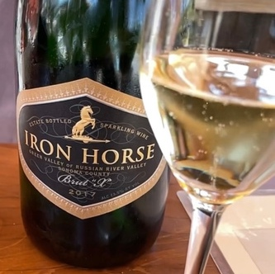
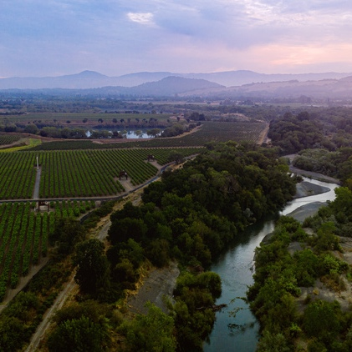
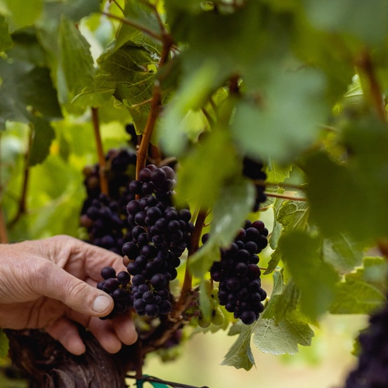
1976
1980
1983
1996
The Judgement
of Paris
First Vintage of Sparkling Wine
Russian River Valley earns AVA designation
RRVW Established
A blind tasting in Paris shocks the wine world when a Chardonnay from California takes the top score. The wine, a 1973 Chateau Monetelena Chardonnay is made from Russian River fruit grown by the Bachigalupi family
Audrey and Barry Sterling release the first vintage of Iron Horse sparkling wine from their Green Valley estate
The Russian River AVA is established to cover 96,400 acres (6,475 hectares), it would later be expanded to cover 126,600 acres (51,233 hectares).
The same year, Green Valley earns AVA designation
Passionate local winegrowers, including Saralee Kunde, establish Russian River Valley Winegrowers to promote the AVA as the premier region for growing cool-climate winegrapes

Slide 14
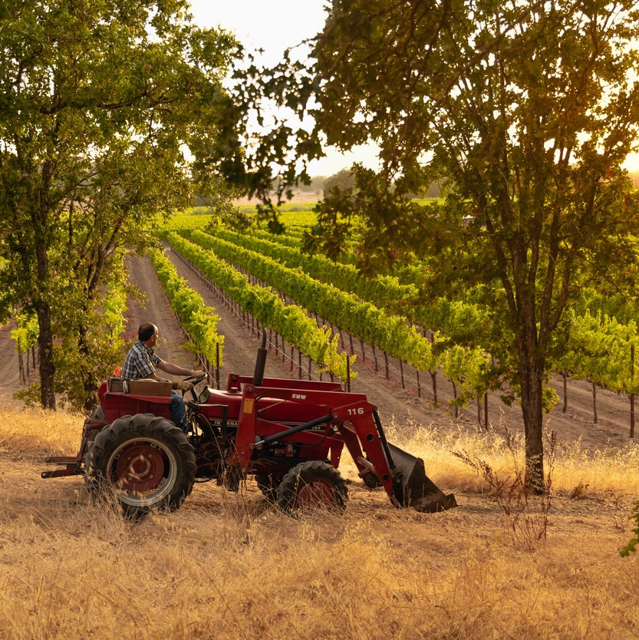

Pinot & Beyond
Russian River Valley is known world-wide as a historic and premier wine region for growing quality Pinot Noir, Chardonnay and many other excellent cool-climate varities

Slide 15
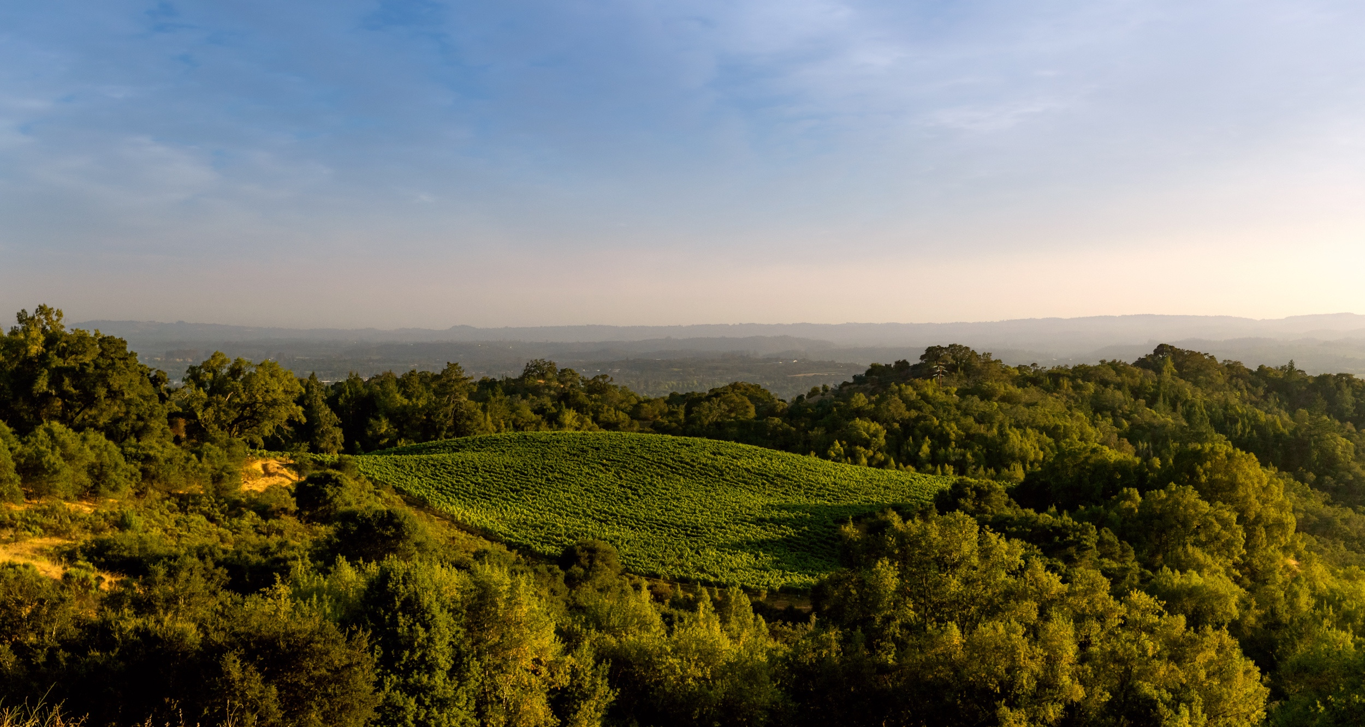


Slide 16

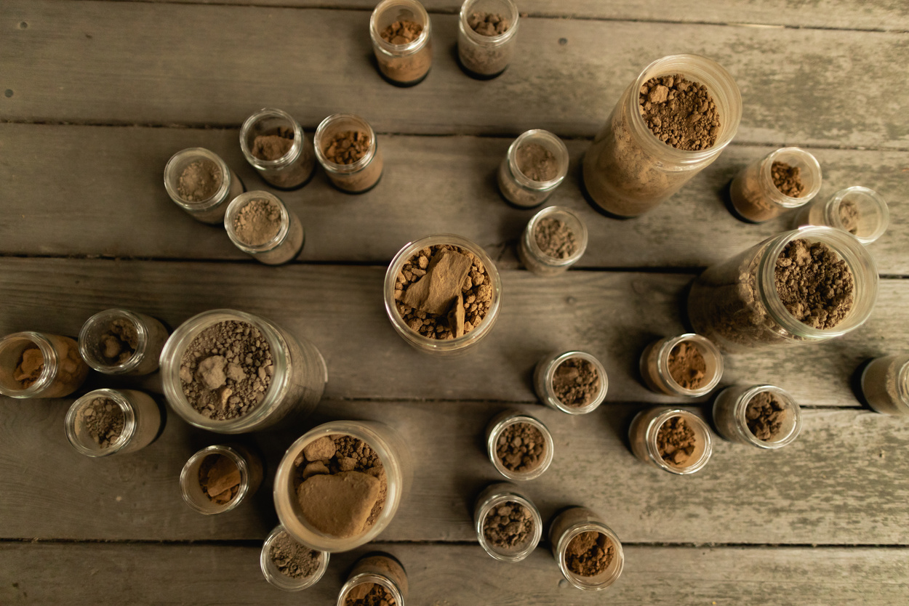
  The Russian River Valley features many different soil types which helps to foster the diversity of wine grapes being grown throughout the county
  One of the unique soil types in the region is Goldridge soil, which is a combination of fractured sandstone and sandy loam create Goldridge soil, ideal for cool-climate grapes

Slide 17

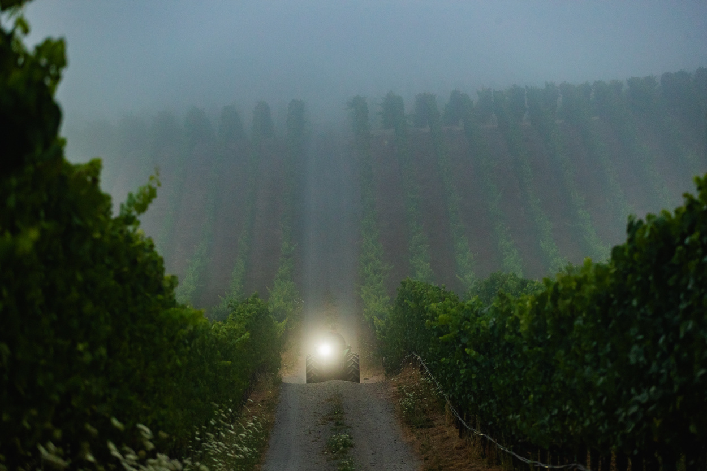
  The Russian River Valley's proximity to the coast creates onshore breezes and fog that cools vineyards
  This seasonal cooling effect varies in intensity throughout different areas of the valley; the effect is differing wine textures, from structured to silky
  While the Russian River Valley can experience warm days in summer months, the temperature generally does not rise above 90 degrees, and experiences a high diurnal temperature variation due to the cooling influences experienced in the valley

Slide 18
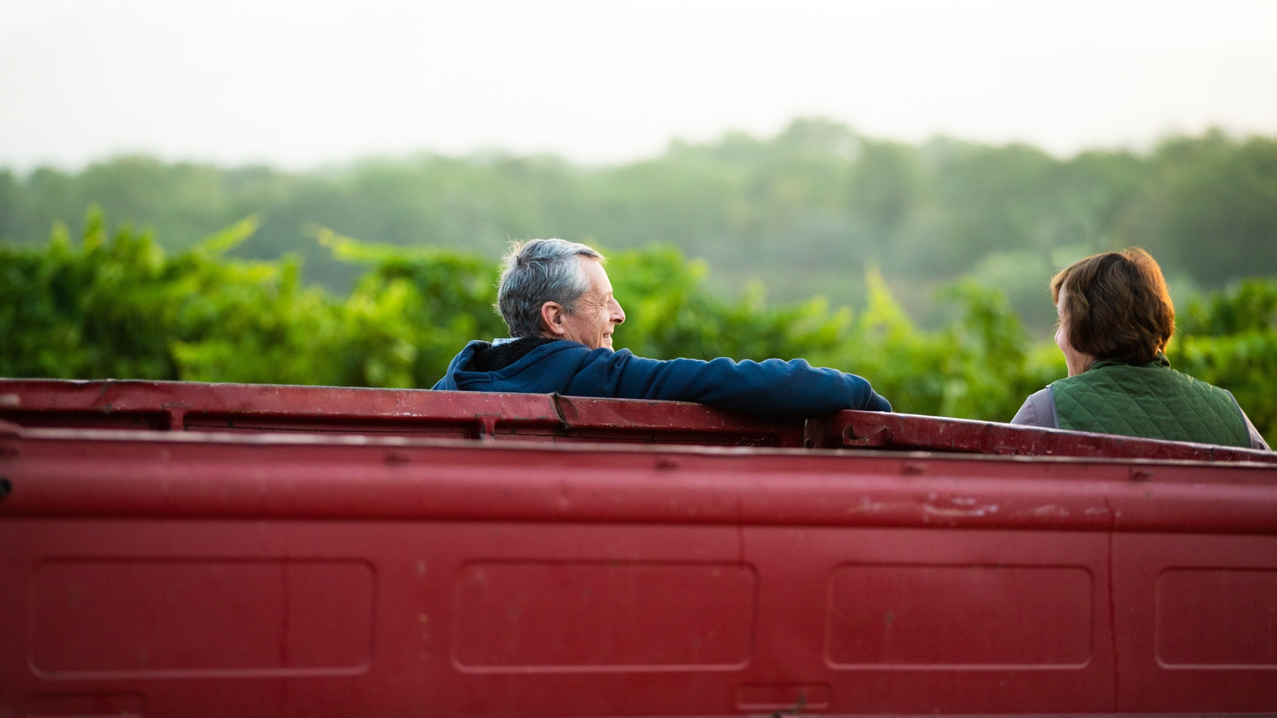


Slide 19
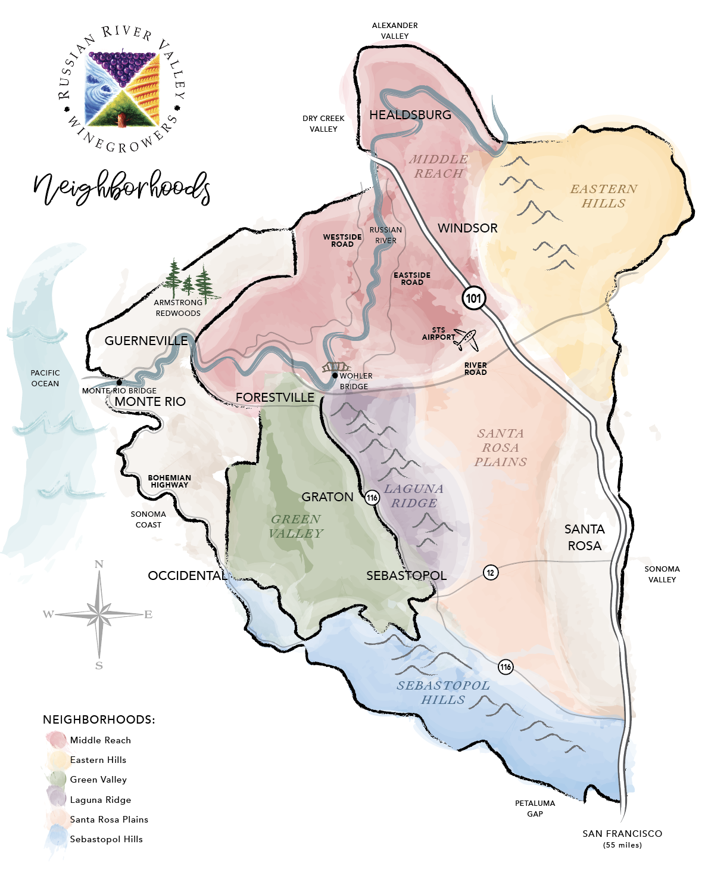

Slide 20

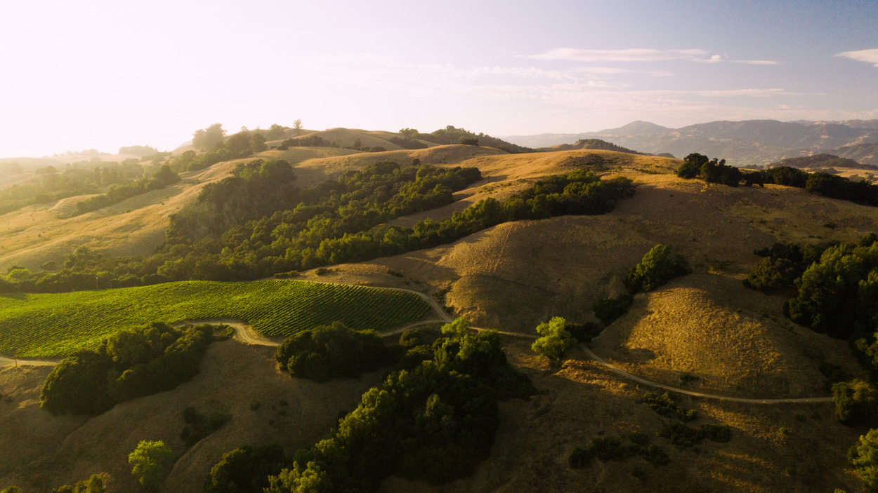
  Russian River Valley has varying climates within the AVA and more soil types than France, which allows for an array of flavor profiles in wine
  Like a city filled with diverse communities, Russian River Valley consists of six smaller neighborhoods stretching from Sebastopol to Santa Rosa and Forestville to Healdsburg
  These unique "neighborhoods" and the award-winning wines they produce are a unique way to take wine lovers on a journey of exploration through the valley
  Unlike AVAs, neighborhoods are not defined by hard boundaries, with the exception being Green Valley, which is also an AVA

Slide 21
The
Neighborhoods
  Russian River Valley has varying climates within the AVA and more soil types than France, which allows for an array of flavor profiles in wine
  Like a city filled with diverse communities, Russian River Valley consists of six smaller neighborhoods stretching from Sebastopol to Santa Rosa and Forestville to Healdsburg
  These unique "neighborhoods" and the award-winning wines they produce are a unique way to take wine lovers on a journey of exploration through the valley
  Unlike AVAs, neighborhoods are not defined by hard boundaries, with the exception being Green Valley, which is also an AVA

Slide 22

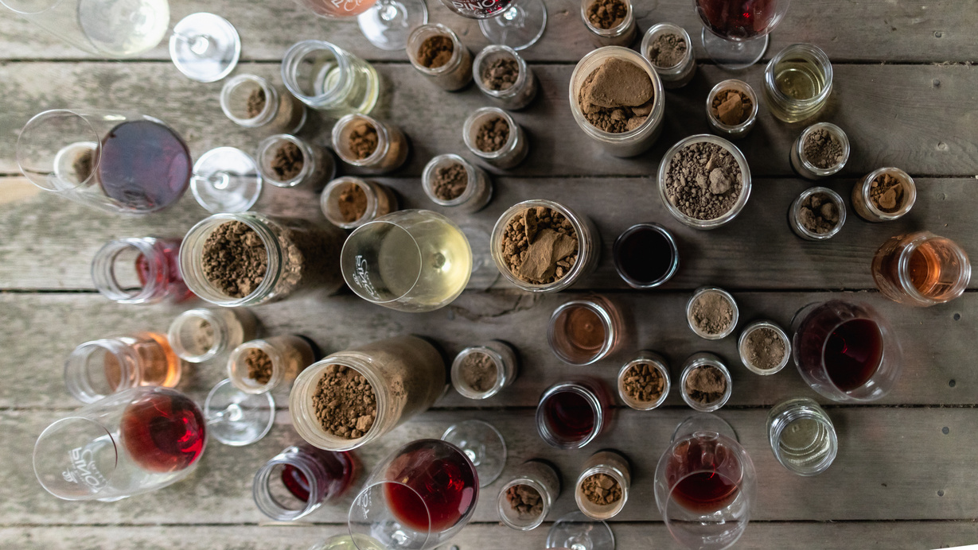
RESEARCH
  In 2015, Dr. Roger Boulton, Professor of Viticulture and Enology at UC Davis prepared an elemental analysis to study wines from the 6 neighborhoods to determine whether there were scientific differences in the juice
  In 2019, Dr. Boulton called his findings "the most compelling scientific evidence that I have seen in my 40-year academic career." He found that Pinot Noir from the six neighborhoods had a unique elemental composition, which is reproducible and which he calls a "fingerprint"
  This research removed subjective elements of smelling or tasting and confirmed what growers and winemakers have known for years - that there are characteristics in wines from Russian River that are unique to the area they are grown

Slide 23
"Fingerprint"
RESEARCH
  In 2015, Dr. Roger Boulton, Professor of Viticulture and Enology at UC Davis prepared an elemental analysis to study wines from the 6 neighborhoods to determine whether there were scientific differences in the juice
  In 2019, Dr. Boulton called his findings "the most compelling scientific evidence that I have seen in my 40-year academic career." He found that Pinot Noir from the six neighborhoods had a unique elemental composition, which is reproducible and which he calls a "fingerprint"
  This research removed subjective elements of smelling or tasting and confirmed what growers and winemakers have known for years - that there are characteristics in wines from Russian River that are unique to the area they are grown

Slide 24

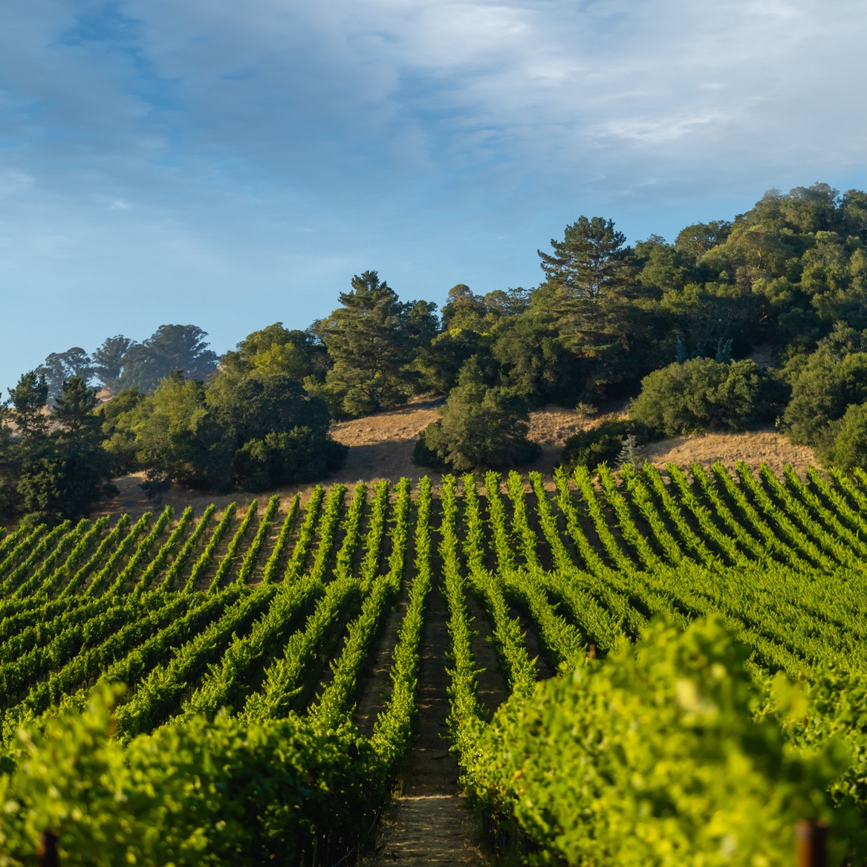
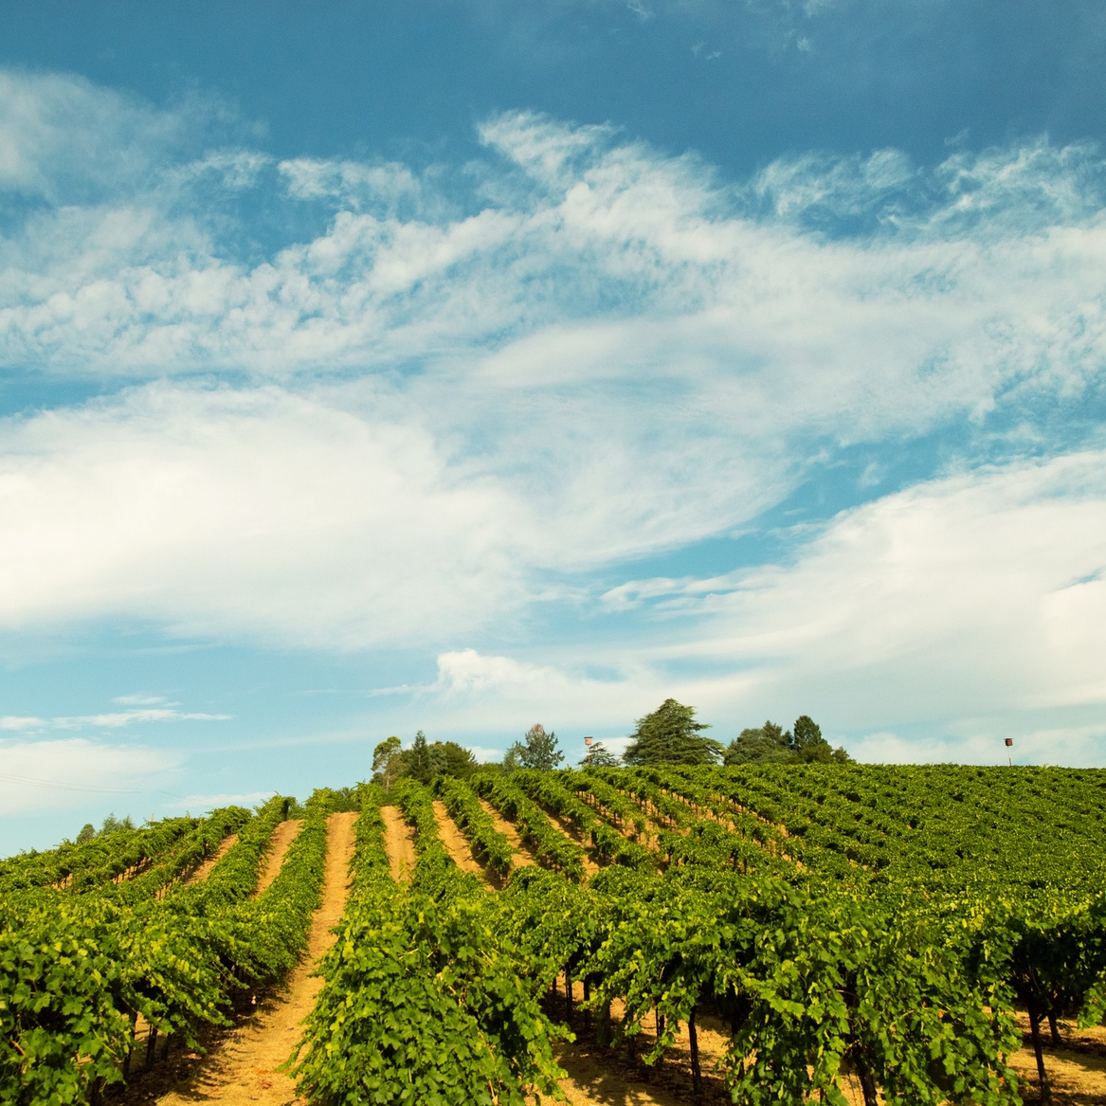
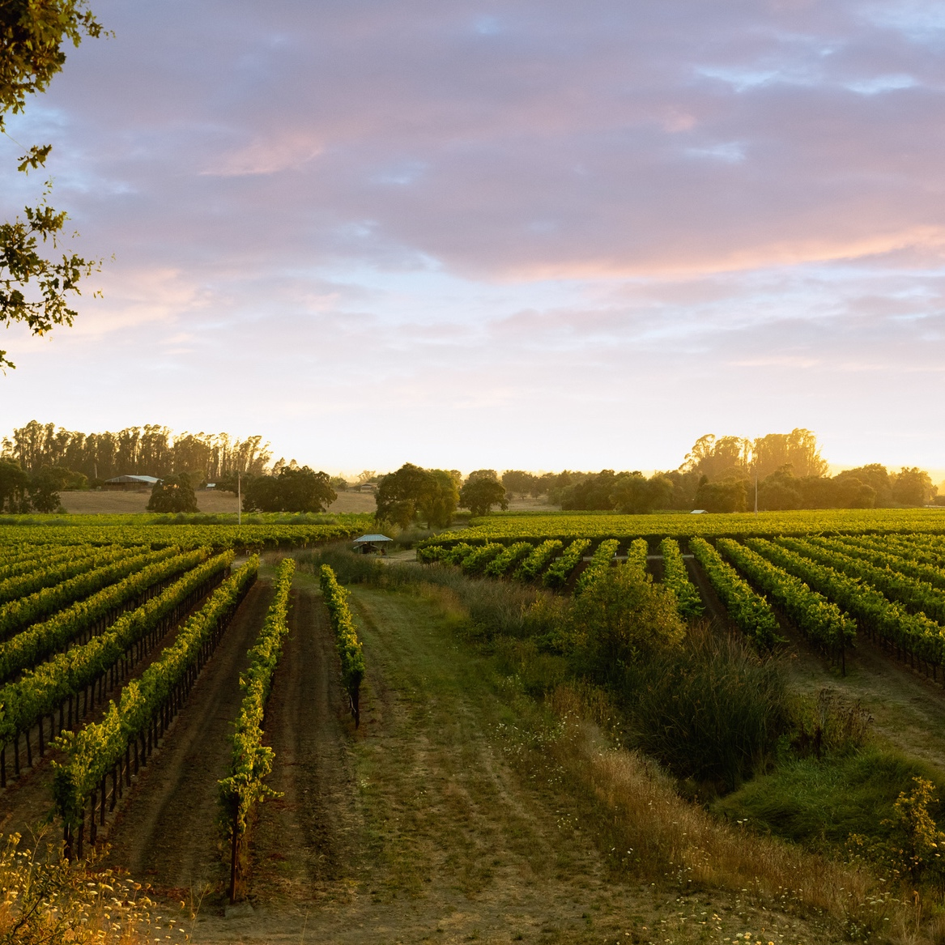
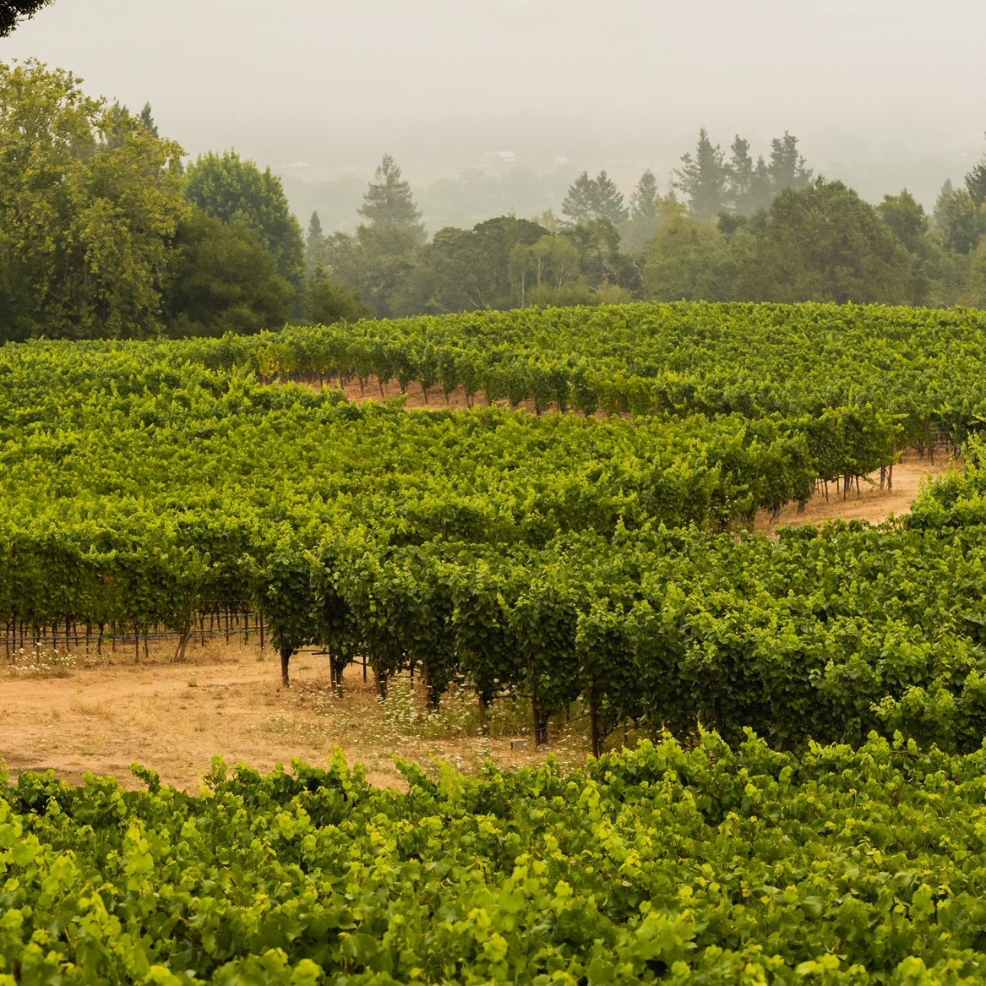
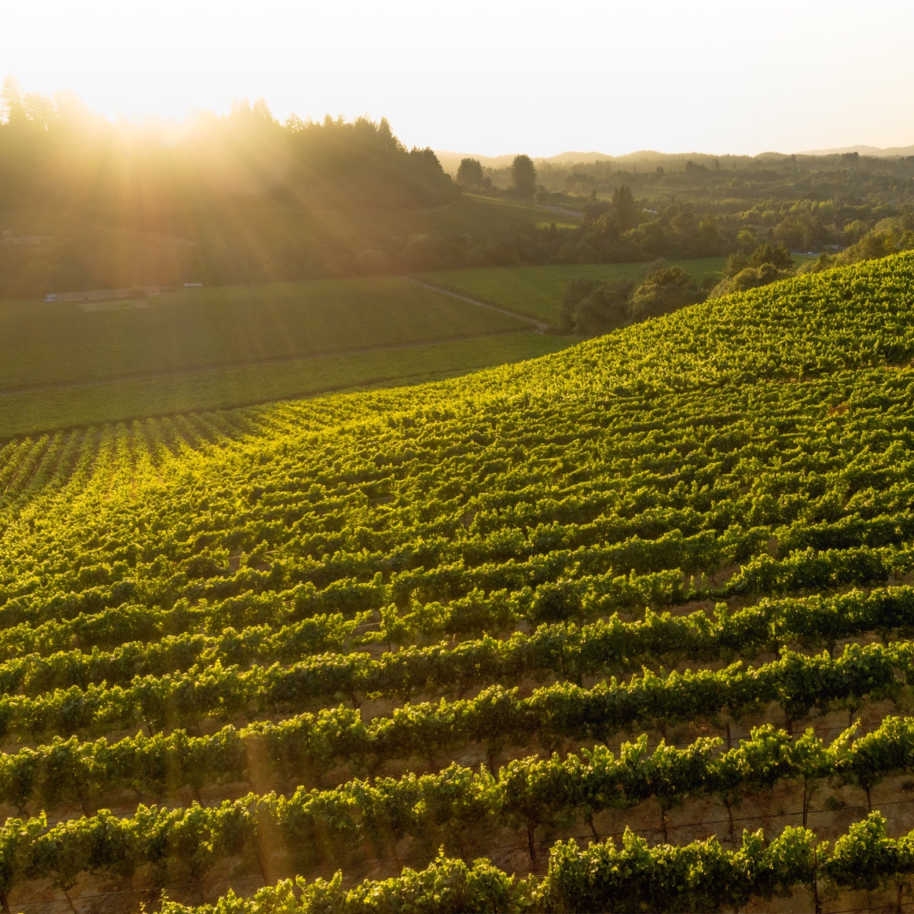
Eastern Hills
Middle Reach
Santa Rosa Plains
Laguna Ridge
Green Valley
Sebastopol Hills

Slide 25
The Six Neighborhoods
Eastern Hills
Middle Reach
Santa Rosa Plains
Laguna Ridge
Green Valley
Sebastopol Hills

Slide 26
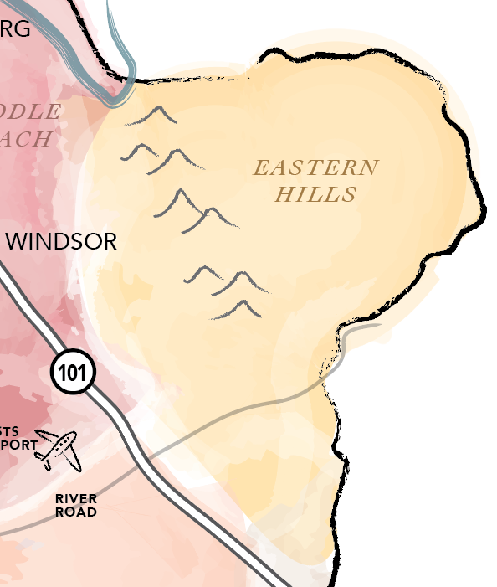

Eastern Hills
Following the western edge of the Mayacamas Mountain range, this is the easternmost neighborhood
Stretches East of the 101 freeway and the town of Windsor

Slide 27

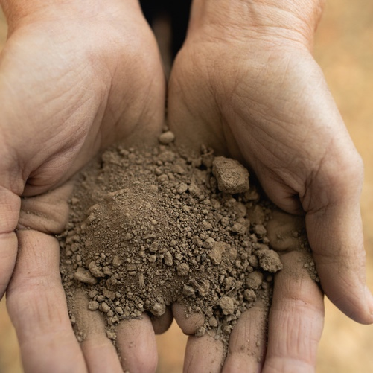
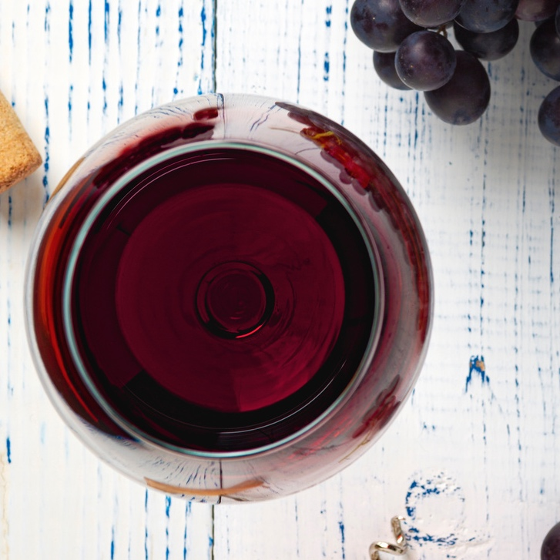
Eastern Hills
Fast Facts
Warm Climate
Diverse Soils
Bold Wines
Eastern Hills has the least fog influence and the warmest climate due to afternoon sun
This region may have the most diversity in soils, with both volcanic and sedimentary soils represented
The wines in this region tend to be deep and bold

Slide 28
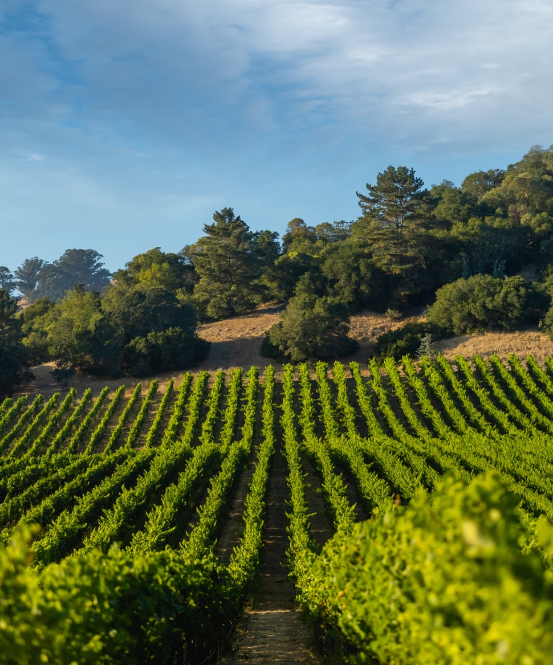
Eastern Hills
  Most diverse within itself due to different soil types
  Grapes ripen earlier than other neighborhoods due to the warm influence of the sun
  Pinot Noir from Eastern Hills is characterized by intensity

Slide 29

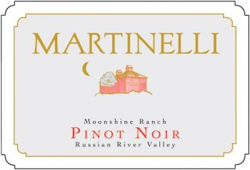
Wine 1: Eastern Hills
Martinelli 2013 Pinot Noir, Moonshine Ranch
  wine info 1
  wine info 2
  wine info 3

Slide 30
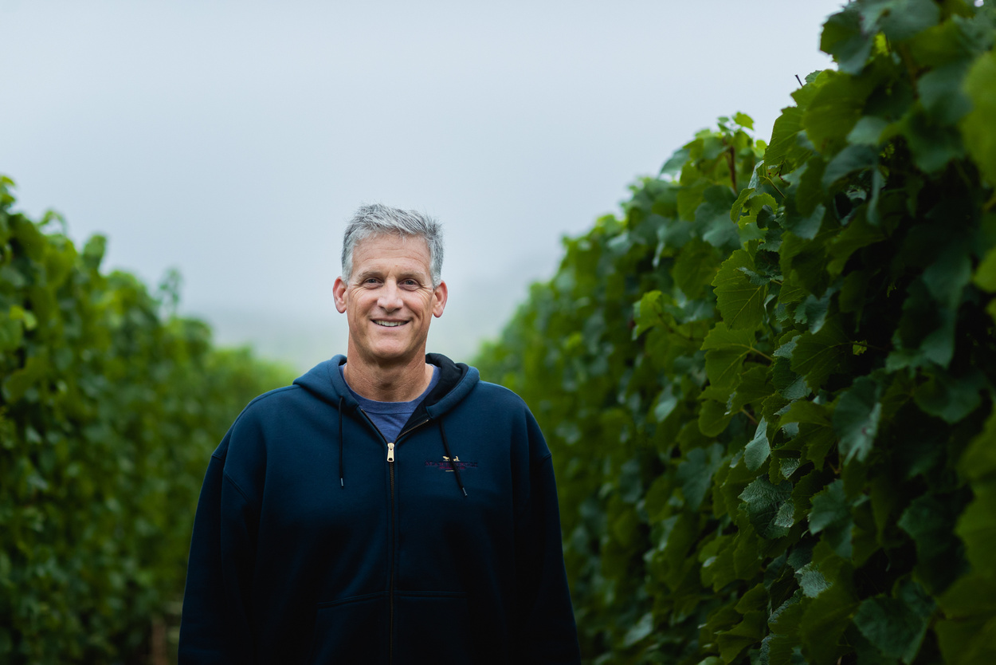
Eastern Hills: George Martinelli
  Fifth generation wine grower
  Oversees winemaking and grower relations
  Additional Fact 3

Slide 31
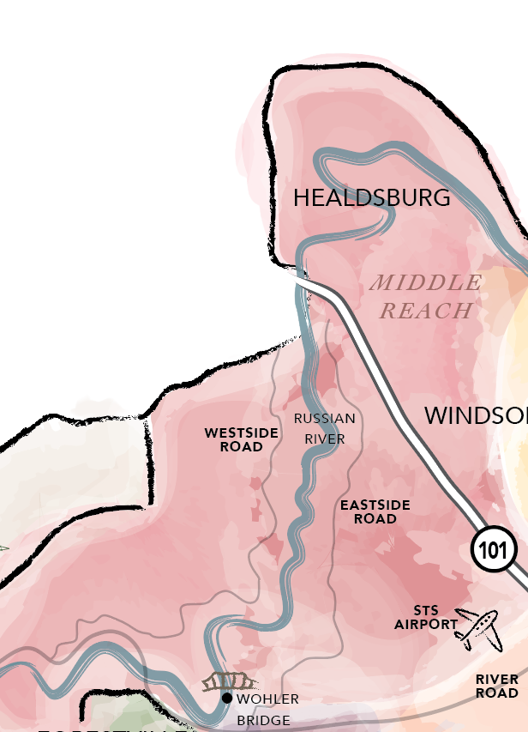

Middle Reach: Location
Near southern Healdsburg and Dry Creek Valley, Middle Reach is the northernmost neighborhood and is closest to the Russian River itself
Middle Reach encompasses Windsor and the vineyards along Westside Road

Slide 32
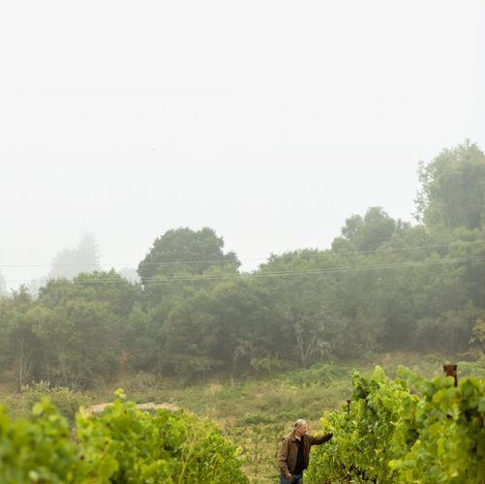
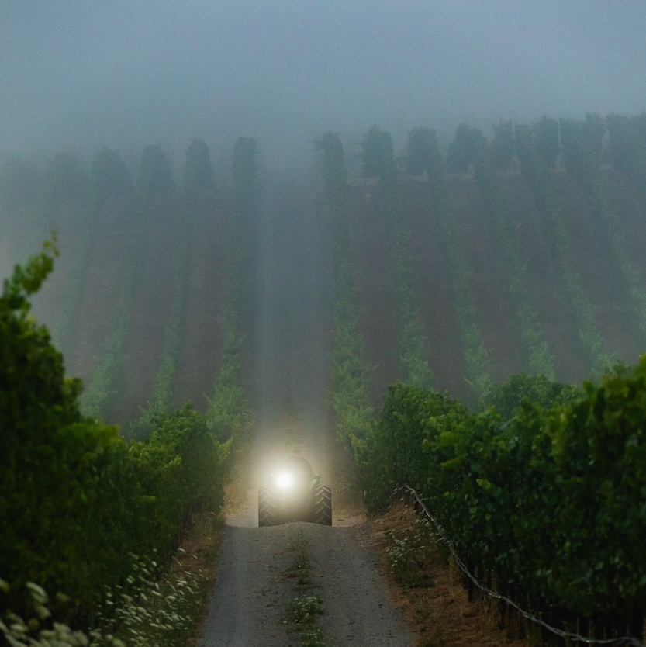
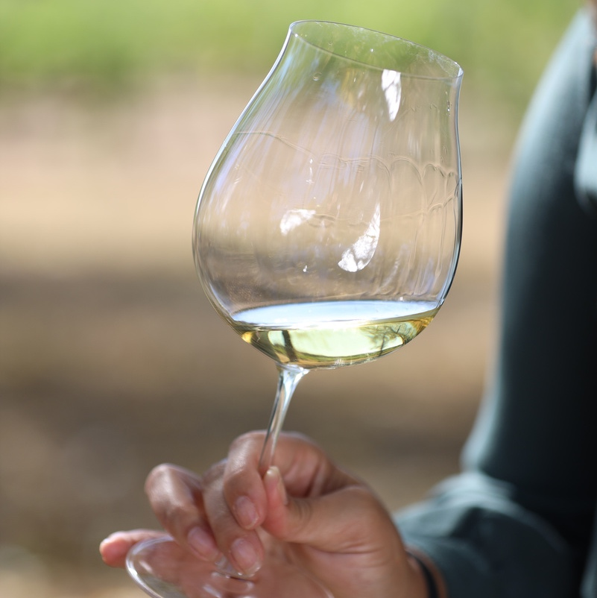
Middle Reach
Fast Facts
Old Vines
Fog
Wines
Middle Reach boasts some of the oldest vineyards that are still producing today
Fog and cooling influences come in from the river, which runs right through this neighborhood
Wines tend to be textured with ripe flavors and are less aromatic

Slide 33
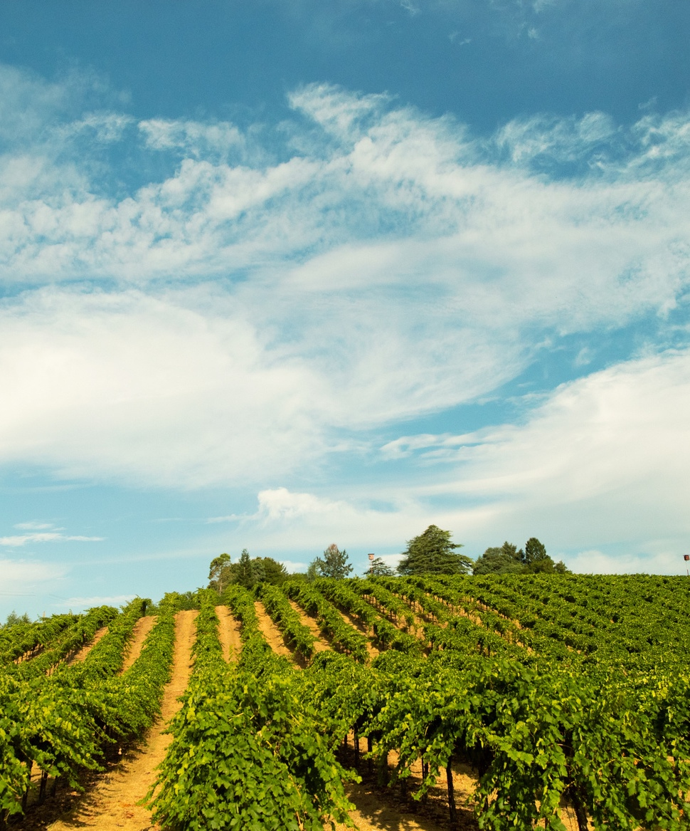

Middle Reach
  Aromatics in wine are less-defined
  Wines are textured, long and broad on the palate. They have firm tannins but are lush and soft
  Pinot Noirs tend to be dark, ripe, full-bodied and built to age well
  The region is not exceptionally hot and the fog from the river is dense, particularly in the summer

Slide 34

Wine 2: Middle Reach
Martinelli 2013 Pinot Noir, Moonshine Ranch
  wine info 1
  wine info 2
  wine info 3

Slide 35
Middle Reach: George Martinelli
  Fifth generation wine grower
  Oversees winemaking and grower relations
  Additional Fact 3

Slide 36
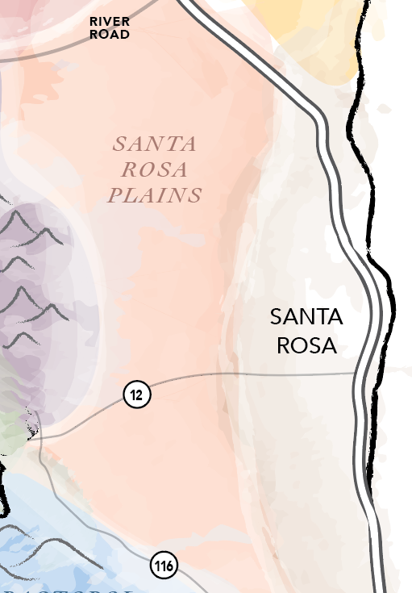

Santa Rosa Plains
Location
Santa Rosa Plains is the area closest to Santa Rosa on the east side of the Laguna de Santa Rosa
Encompasses Olivet Road and the Piner-Olivet area

Slide 37
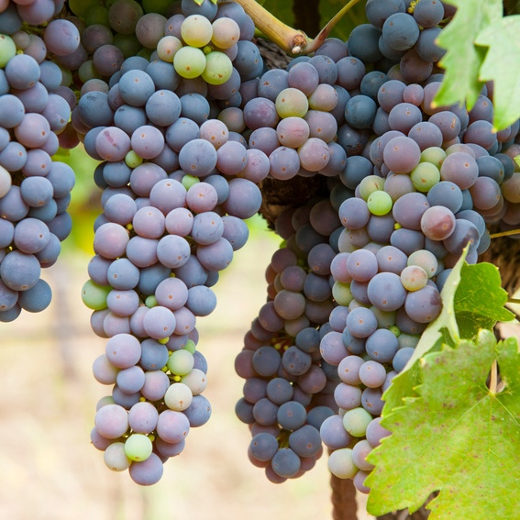
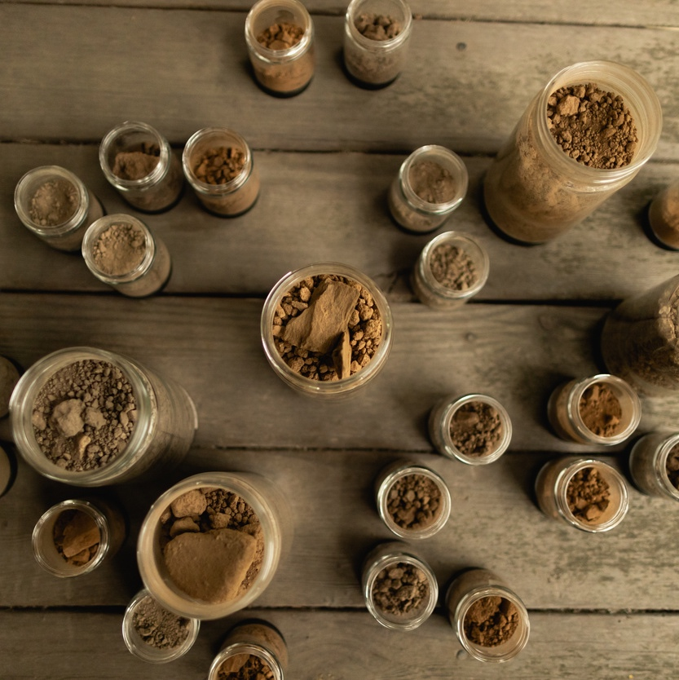
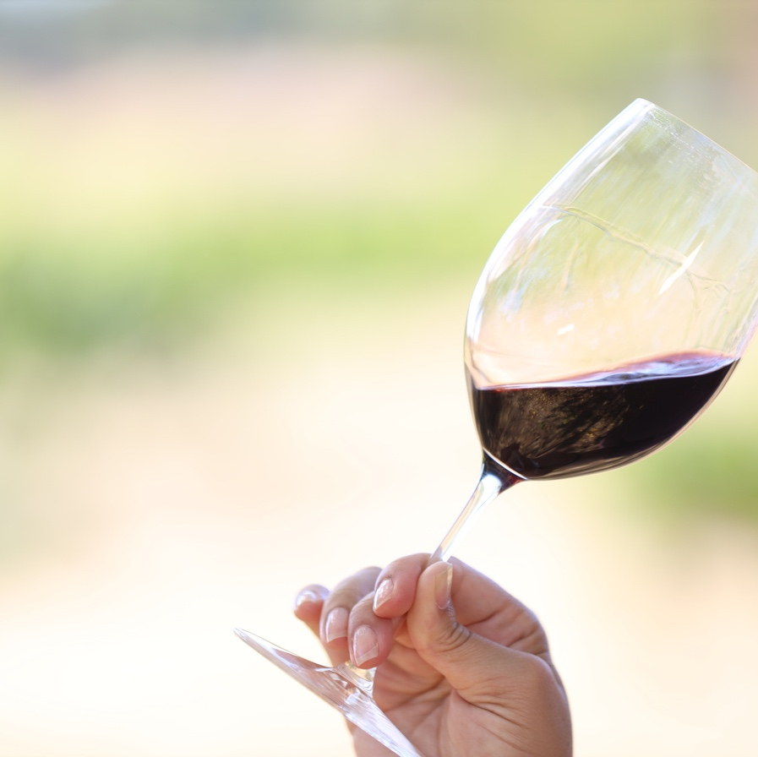
Santa Rosa Plains
Fast Facts
Zinfandel
Soils
Wines
This neighborhood is well-known for being home to the valley's oldest Zinfandel vines
Primarily shale, sandstone and clay soils
The unique soil profile yield spicy, raspberry influenced Zinfandels and other red wines

Slide 38
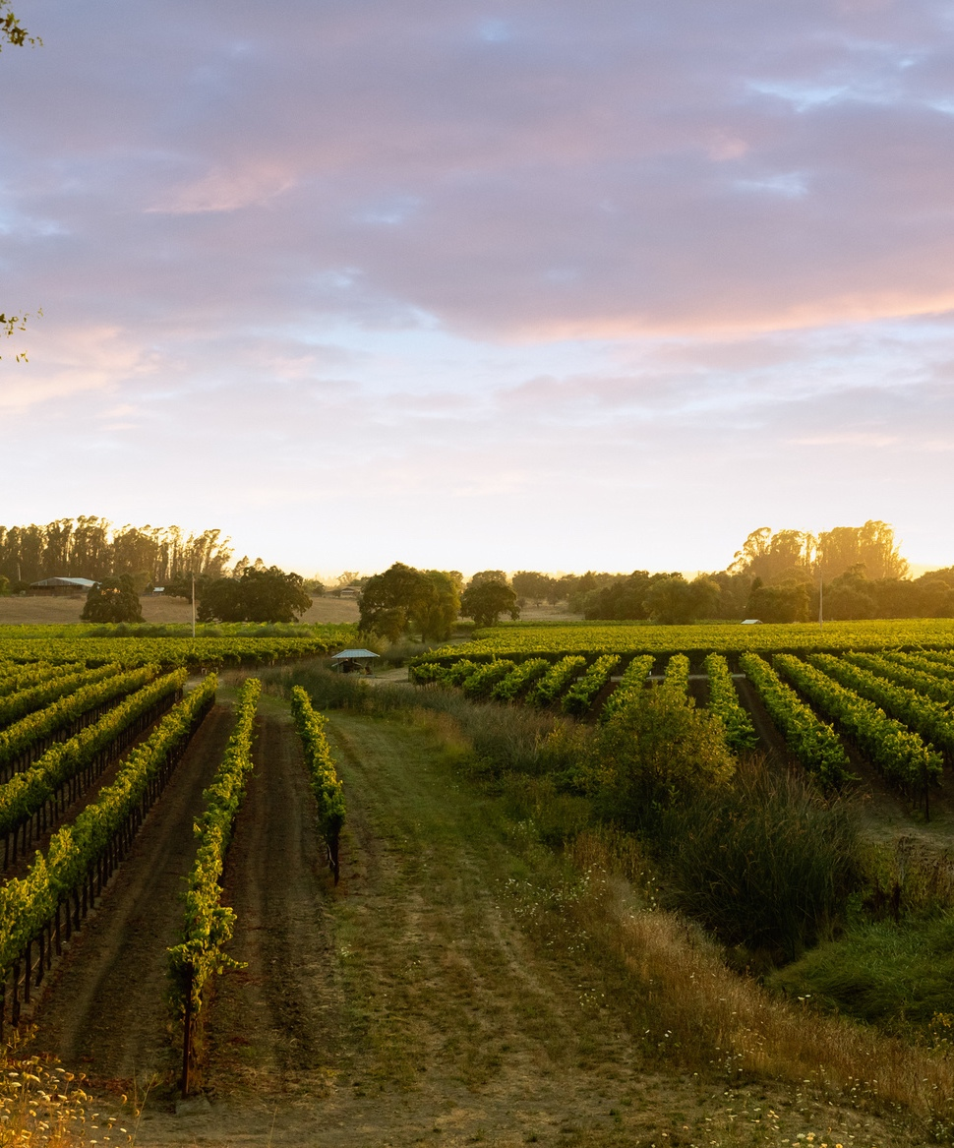
Santa Rosa Plains
  Vineyards and wineries are strongly populated in this neighborhood
  Expresses red fruit characteristics in Zinfandel and Pinot Noir
  Many of the Pinot Noir vineyards are planted with Martini clone, one of the oldest clones in the AVA, characterized by large berries

Slide 39

Wine 3: Santa Rosa Plains
Martinelli 2013 Pinot Noir, Moonshine Ranch
  wine info 1
  wine info 2
  wine info 3

Slide 40
Santa Rosa Plains:
George Martinelli
  Fifth generation wine grower
  Oversees winemaking and grower relations
  Additional Fact 3

Slide 41
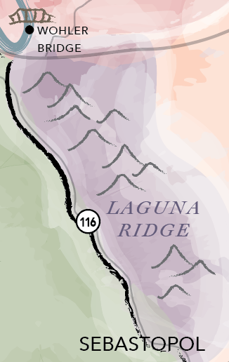

Laguna Ridge
Location
South of the Russian River near Forestville and northeast of Sebastopol, this neighborhood overlooks the Laguna de Santa Rosa

Slide 42
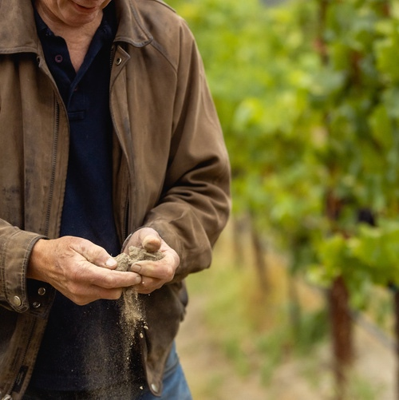


Laguna Ridge
Fast Facts
Cool Temperatures
Soils
Wines
This relatively cool (but not cold) neighborhood creates lush, high-quality Pinot Noir with enough tannins to age gracefully
Characterized by well-draining sandy Goldridge and Altamont soils
Pinot Noirs are balanced, with moderate acidity, red fruit and spice characteristics

Slide 43

Laguna Ridge
  Joseph Swan was first to plant Pinot Noir in this neighborhood on the advice of Andre Tchelistcheff, who called the area "middle-cool"
  In relation to the other Russian River neighborhoods, Laguna Ridge is in the middle in terms of climate: not as cool as Green Valley or Sebastopol Hills and not as warm as Eastern Hills, Middle Reach or Santa Rosa Plain

Slide 44

Wine 4:Laguna Ridge
Martinelli 2013 Pinot Noir, Moonshine Ranch
  wine info 1
  wine info 2
  wine info 3

Slide 45
Laguna Ridge:
George Martinelli
  Fifth generation wine grower
  Oversees winemaking and grower relations
  Additional Fact 3

Slide 46


Green Valley Location
South of Forestville and north of Sebastopol, Green Valley includes the towns of Graton and Occidental

Slide 47


Green Valley
Fast Facts
Green Valley is an AVA
Soils
Wines
The only one of the neighborhoods to have an official American Viticultural Area designation, assigned in 1983
Green Valley is well-known for having Goldridge soils
Pinot Noirs are known for having ripe tannins, high acid and a luxurious mouthfeel

Slide 48

Green Valley
  The Green Valley AVA name was updated in 2008 and is now officially called "Green Valley of Russian River Valley." It is completely surrounded by the Russian River AVA
  This neighborhood is heavily forested with redwood and fir trees and is one of the cooler neighborhoods, being subject to consistent cooling winds from the Pacific Ocean
  In general, Green Valley has a higher elevation than the other neighborhoods, but there are a combination of vineyards on slopes with higher elevation, and in valleys, which are less affected by winds
  Green Valley is heavily populated with vineyards, but not with wineries

Slide 49

Wine 5:Green Valley
Martinelli 2013 Pinot Noir, Moonshine Ranch
  wine info 1
  wine info 2
  wine info 3

Slide 50
Green Valley: George Martinelli
  Fifth generation wine grower
  Oversees winemaking and grower relations
  Additional Fact 3

Slide 51


Sebastopol Hills
Location
Sebastopol Hills spans east and west around the southwest portion of the town of Sebastopol

Slide 52



Sebastopol Hills
Fast Facts
The Coolest Region
Soils
Wines
The climate in Sebastopol Hills is about as cool as it gets within the Russian River Valley AVA
Like Green Valley, the soils in Sebastopol Hills are mostly Goldridge
Crisp red-fruit characteristics. Full-bodied with the right amount of acidity

Slide 53

Sebastopol Hills
  In the 60s and 70s when many vineyards were being planted in the Russian River Valley, people thought it was too cold to plant Pinot Noir in Sebastopol Hills
  Today, fruit from these cooler Russian River vineyards are sought-after and well-acclaimed

Slide 54

Wine 6:Sebastopol Hills
Martinelli 2013 Pinot Noir, Moonshine Ranch
  wine info 1
  wine info 2
  wine info 3

Slide 55
Sebastopol Hills: George Martinelli
  Fifth generation wine grower
  Oversees winemaking and grower relations
  Additional Fact 3

Slide 56



